Slide 1
COMS E6998: Microservices and Cloud Applications Lecture 6: OAuth2, FB, Twitter, Cloud/AWS Security, 12 Factor Applications
Dr. Donald F. Ferguson
dff9@columbia.edu

Slide 2
Contents

Slide 3
Contents
Questions, Comments, Discussion?
(Web/Cloud) Security Concepts 101
Concepts
HTTPS
Certificates, DNS, …
Authentication and Registration
SeekaTV demos: Email, Facebook, Twitter
Email registration/login
Social network registration/login
OAuth2 Overview; Facebook, Twitter
Cloud Security Concepts and AWS Realization
Overview: Identity, Role, Resource, Policy
Application level versus AWS security management
Services and subsystems security
Project 4: Simple Security
12 Factor Application

Slide 4
Questions? Comments? Discussion

Slide 5
Web/Cloud Security 101 TLS/HTTPS Certificates DNS CloudFront

Slide 6
(Some) Security Facets
Authentication: “ (…) is the act of confirming the truth of an attribute of a single piece of data claimed true by an entity. In contrast with identification, which refers to the act of stating or otherwise indicating a claim purportedly attesting to a person or thing's identity, authentication is the process of actually confirming that identity. ”
Authorization:
“The process of authorization is distinct from that of authentication. Whereas authentication is the process of verifying that ‘you are who you say you are’, authorization is the process of verifying that ‘you are permitted to do what you are trying to do’.
“Authorization is the function of specifying access rights/privileges to resources related to information security and computer security in general and to access control in particular ^{[1]}. More formally, "to authorize" is to define an access policy.”
(Communication) Security
“Transport Layer Security (TLS) and its predecessor, Secure Sockets Layer (SSL), both frequently referred to as "SSL", are cryptographic protocols that provide communications security over a computer network.”
“The connection is private (or secure) because symmetric cryptography is used to encrypt the data transmitted.”
The identity of the communicating parties can be authenticated using public-key cryptography.
The connection ensures integrity because each message transmitted includes a message integrity check using a message authentication code to prevent undetected loss or alteration of the data during transmission.
HTTPS (also called HTTP over Transport Layer Security [TLS],^{[1]} HTTP over SSL,^{[2]} and HTTP Secure^{[3][4]}) is a communications protocol for secure communication over a computer network which is widely used on the Internet. HTTPS consists of communication over Hypertext Transfer Protocol (HTTP) within a connection encrypted by Transport Layer Security, or its predecessor, Secure Sockets Layer. The main motivation for HTTPS is authentication of the visited website and protection of the privacy and integrity of the exchanged data.

Slide 7
Alice – Bob – Eve
Eve observes the unencrypted communication.
Probably to do something malicious with the observed information, e.g.
Steal credit card numbers.
Steal login IDs and passwords.

Slide 8
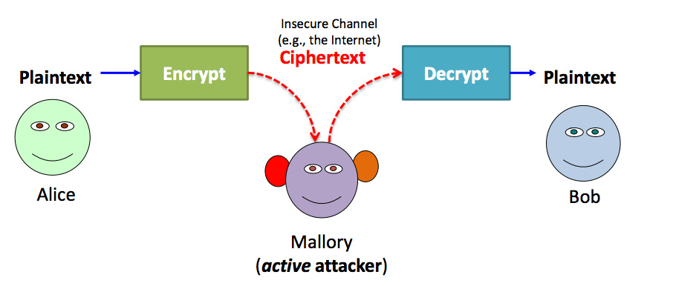
Alice – Bob – Mallory
Mallory intercepts the communication, including any security set up, e.g.
Keys
BASIC-AUTH
Makes Bob think she is Alice and Alice think she is Bob to steal information or send evil messages (e.g. transfer money).

Slide 9
HTTPS
Using
The SSL Certificate
PKI cryptography
Bob can prove identity to Alice.
Alice can send messages to Bob that only Bob can decrypt.
This allows a
Key exchange
To set up a secure channel
But, Alice has not proven identity to Bob.

Slide 10
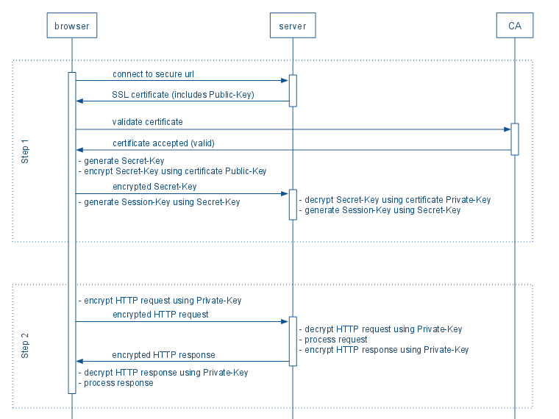
Two Diagrams Explaining HTTPS/TLS

Slide 11
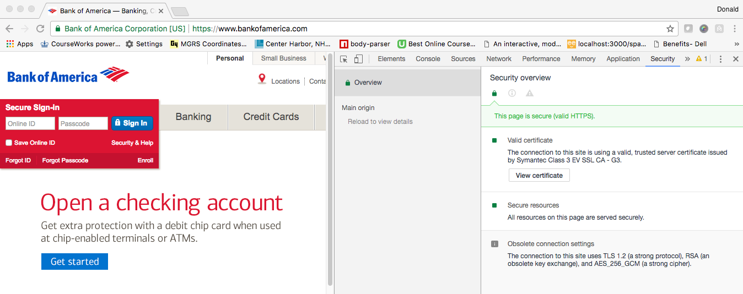
HTTPS Example
I am connected to the owner of bankofamerica.com ➔
I can send the site a shared secret, and be sure no one else can see it.
This works for REST because REST is still HTTP(S).

Slide 12
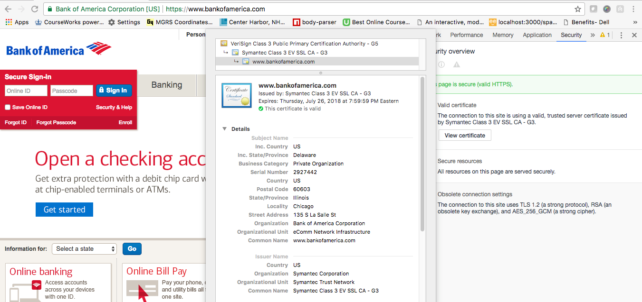
Certificate

Slide 13
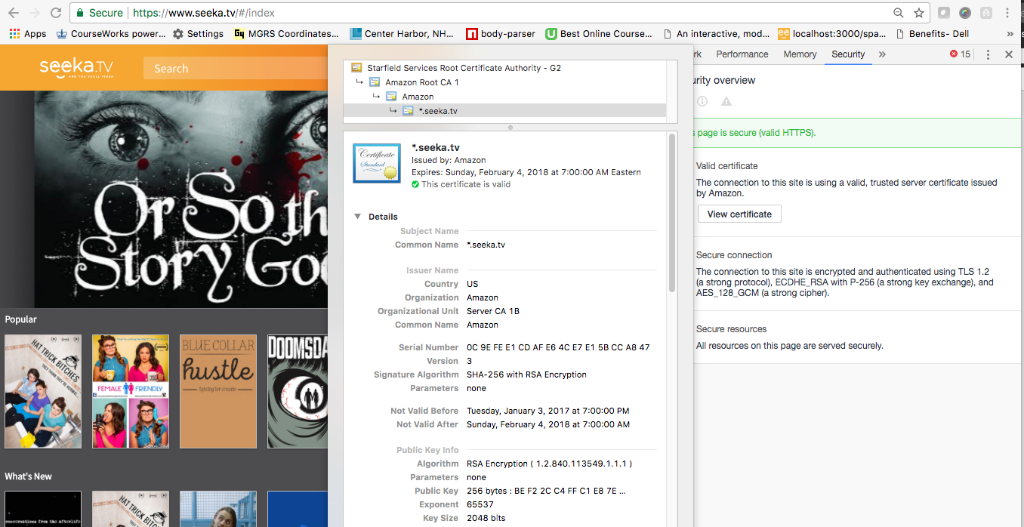
Using Your Certificate

Slide 14
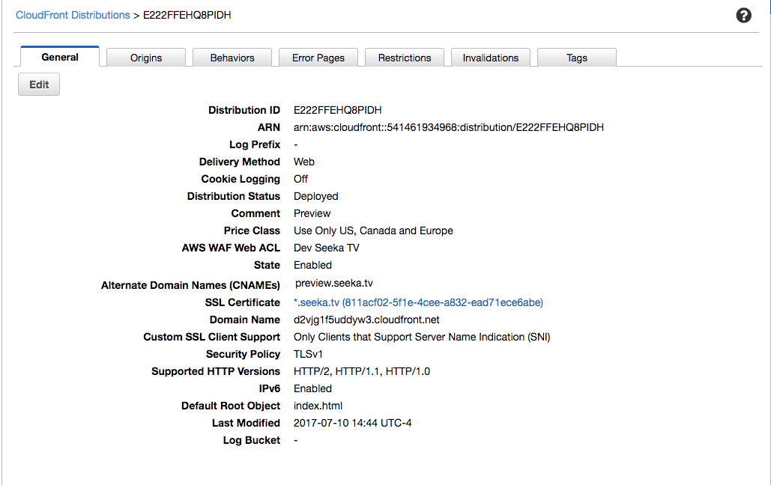
Using Your Certificate

Slide 15
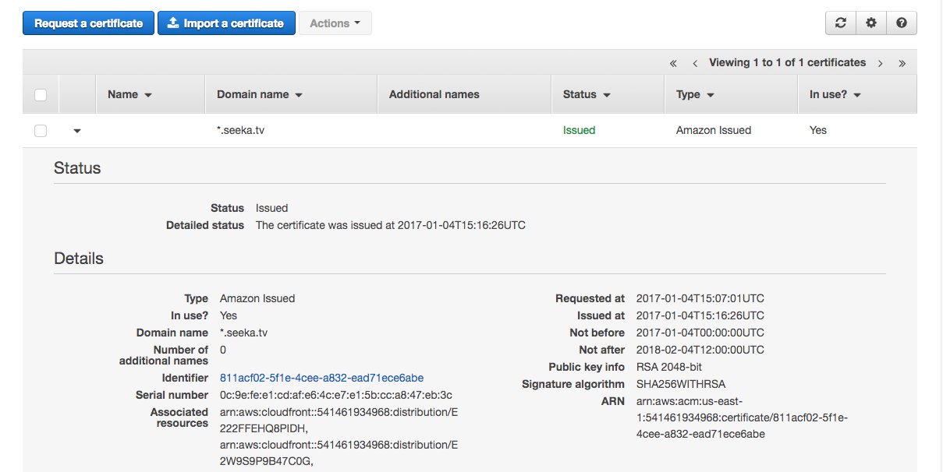
Using Your Certificate

Slide 16
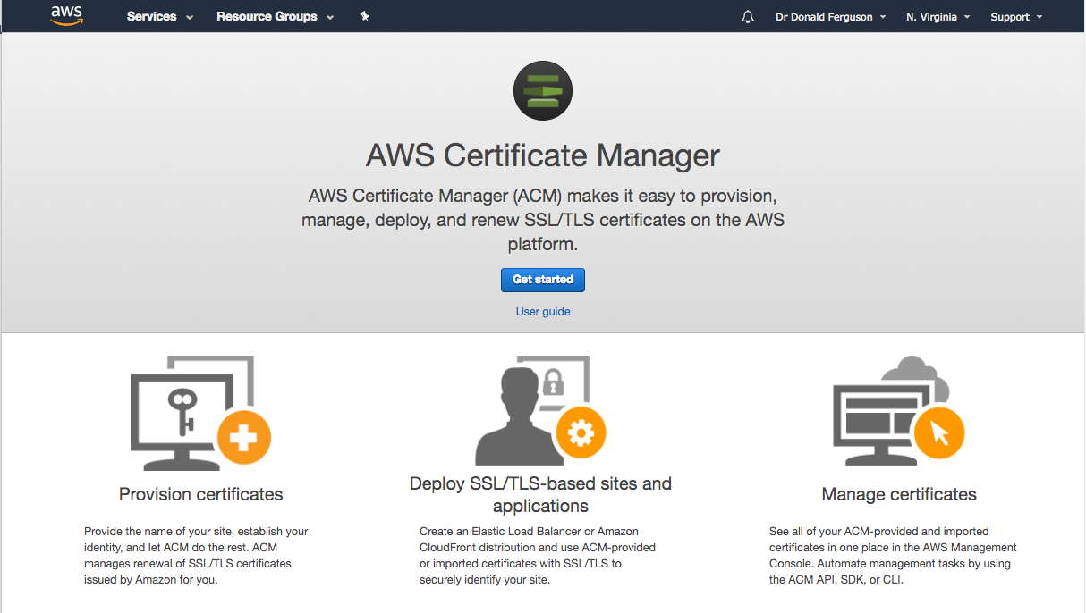
Obtaining a Certificate

Slide 17
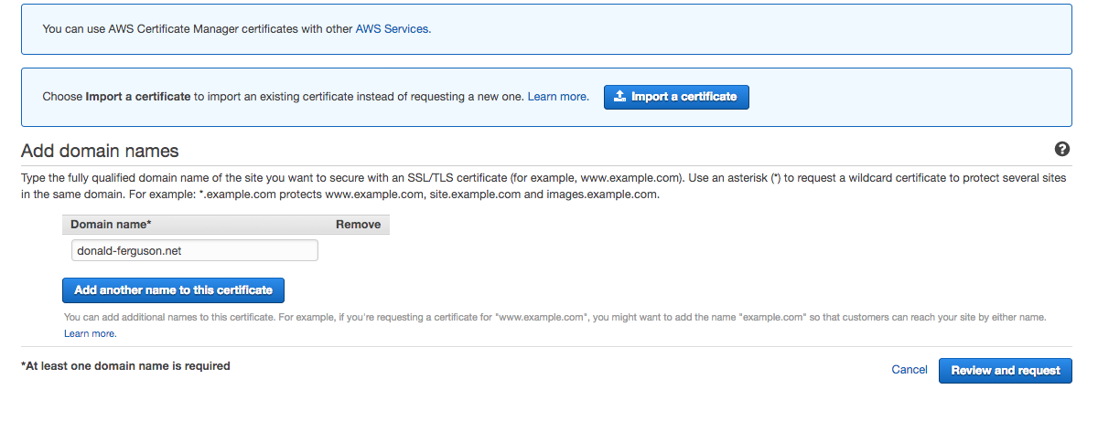
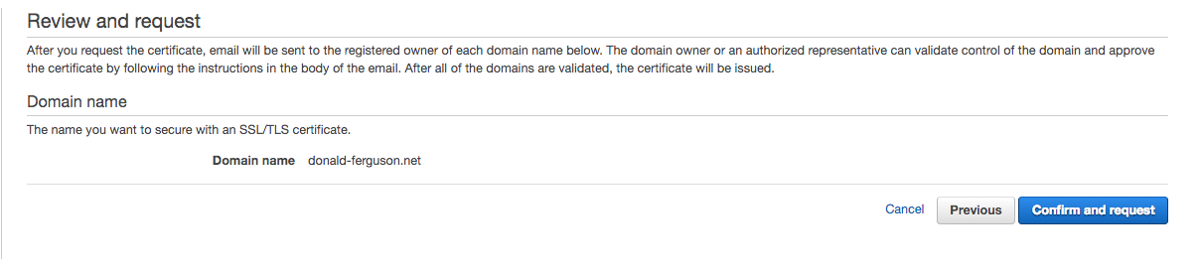

Slide 18
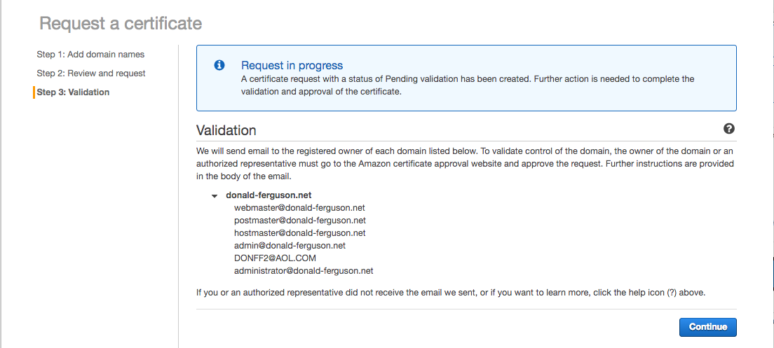

Slide 19
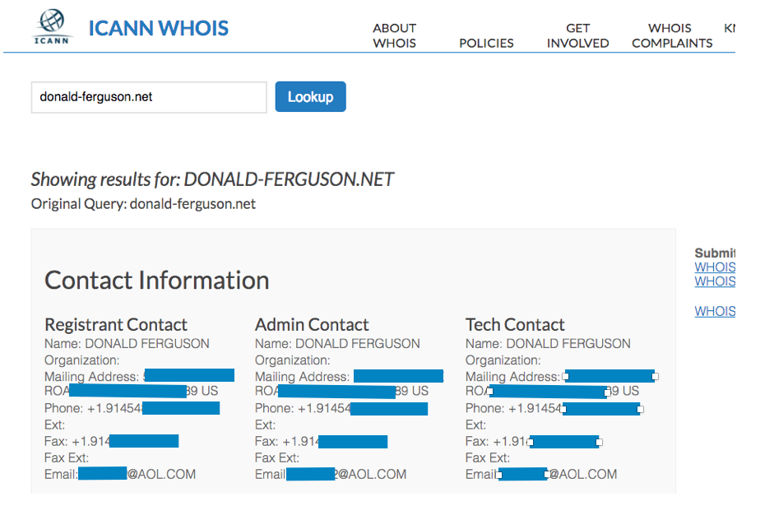
DNS Info

Slide 20
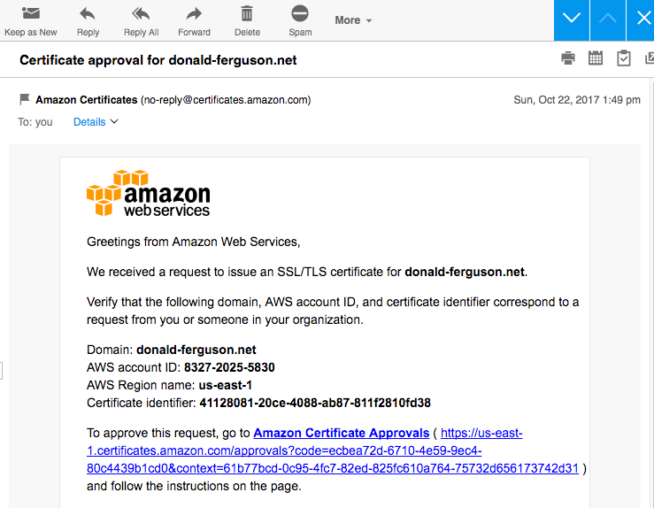

Slide 21
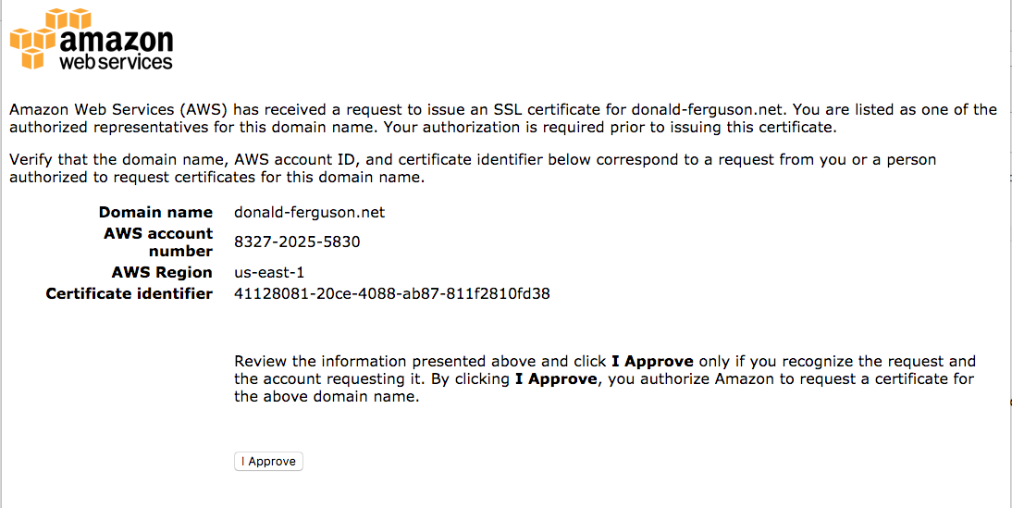

Slide 22
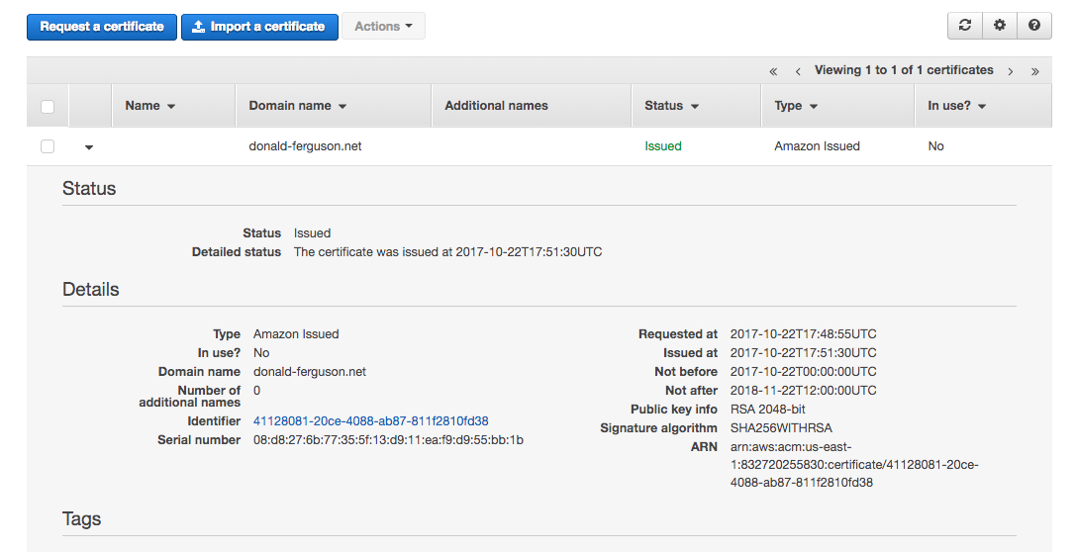
Success

Slide 23
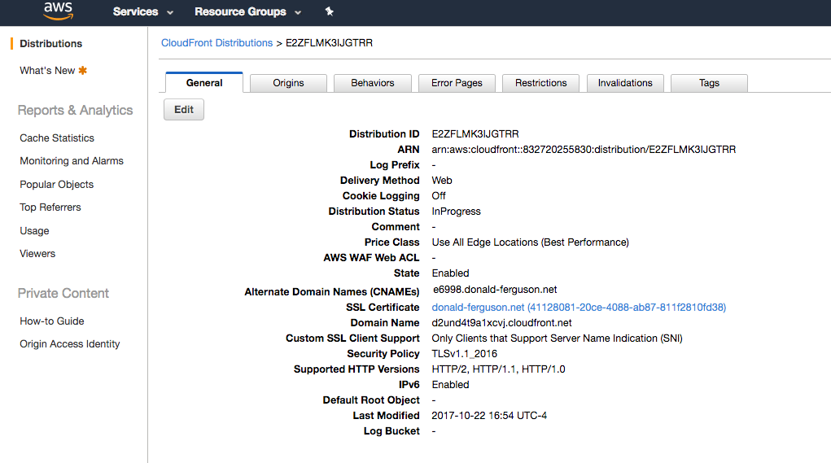
CloudFront Distribution

Slide 24
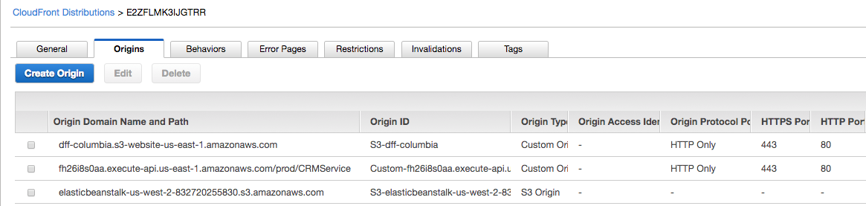
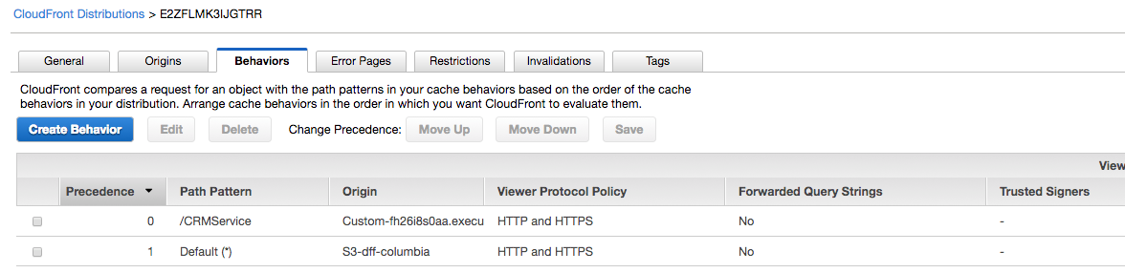
CloudFront Distribution

Slide 25
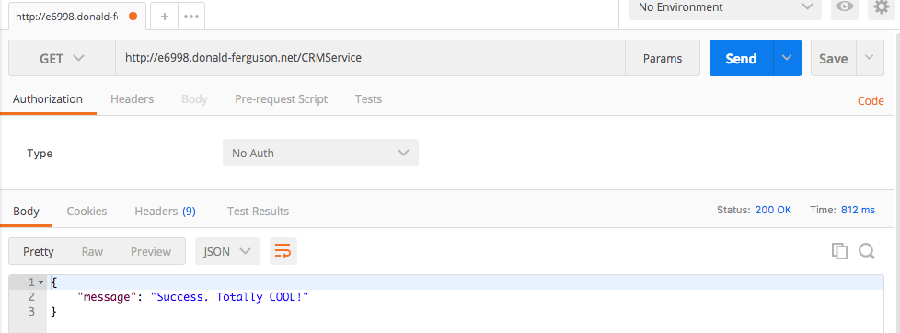
Behaviors

Slide 26
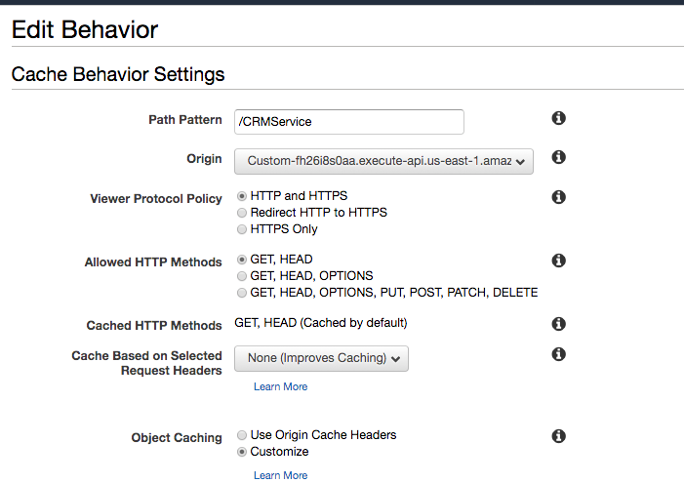
Behavior
Invoke application REST APIs via API Gateway

Slide 27
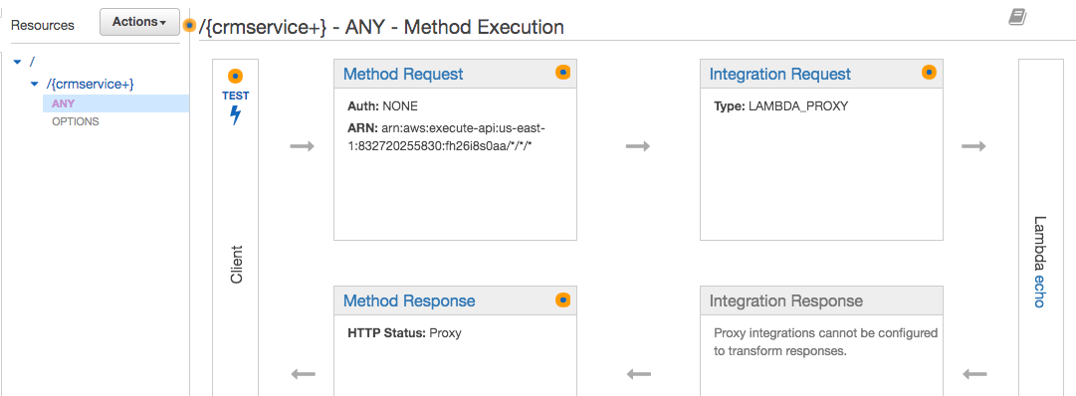
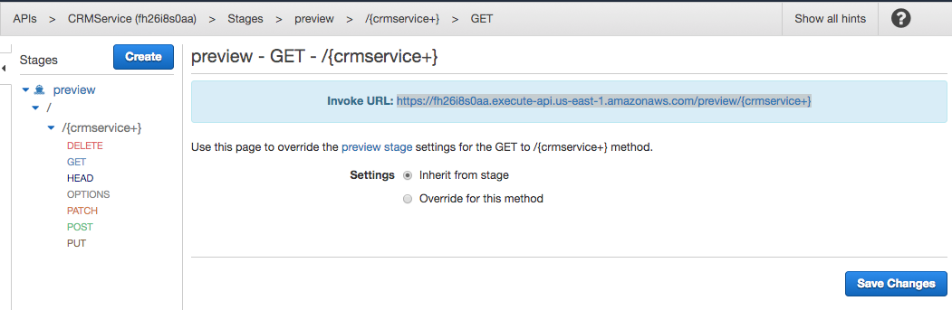
API Gateway Stage

Slide 28
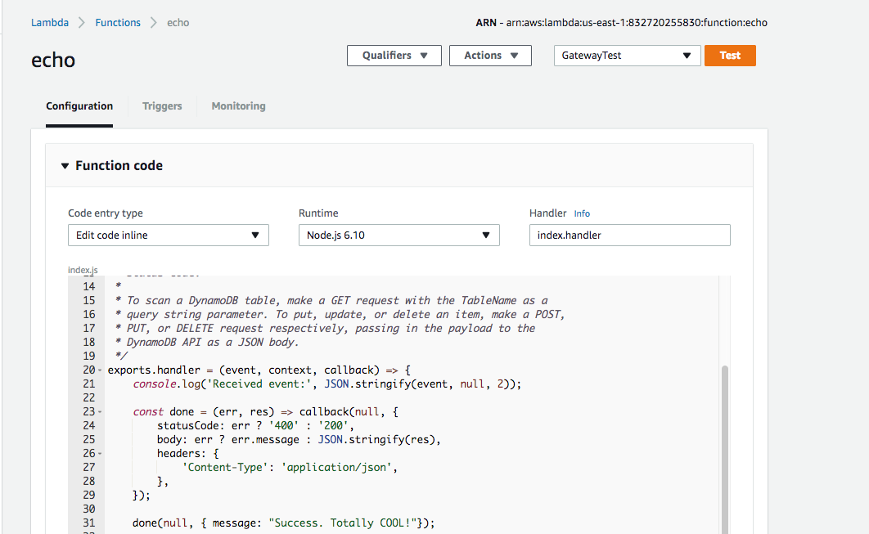
Implementation

Slide 29
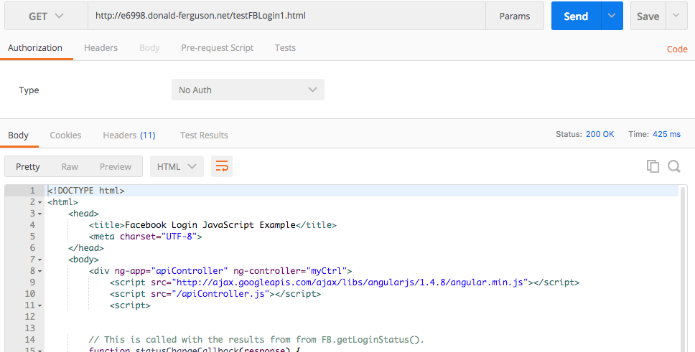
Behaviors

Slide 30
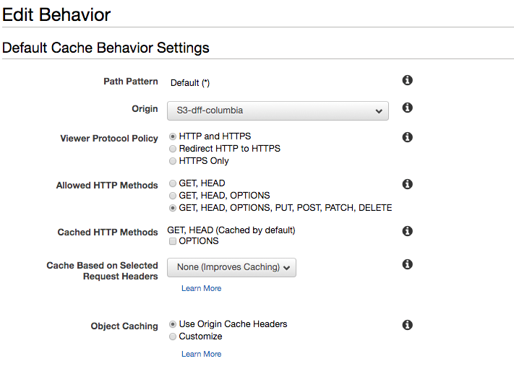
Behavior
Static content in S3

Slide 31
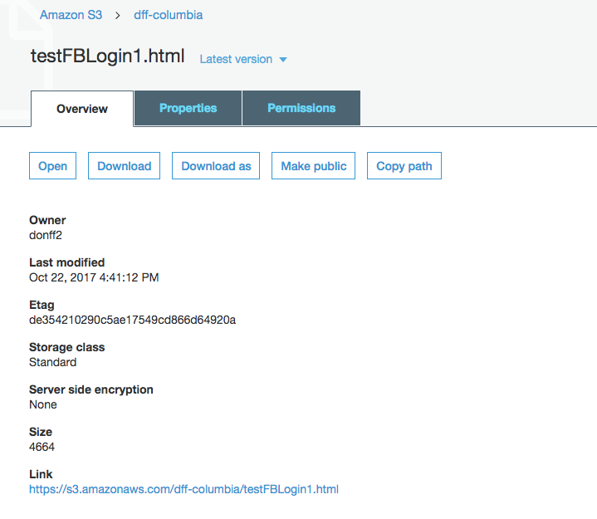
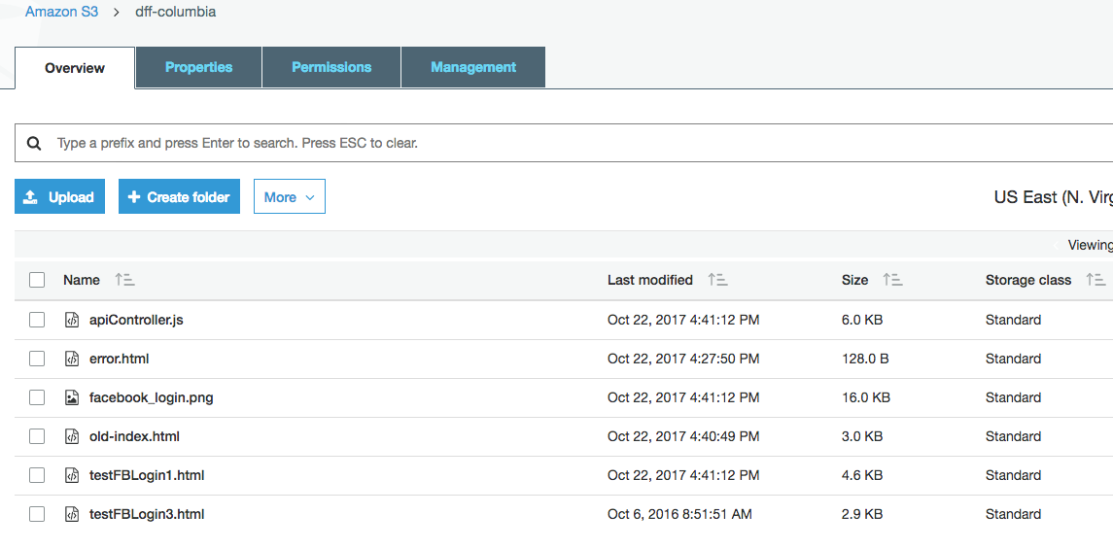
Implementation

Slide 32
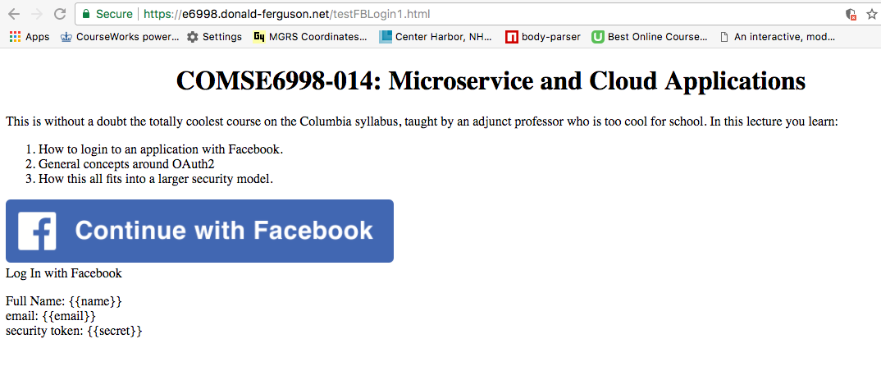
All of this to securely get to …

Slide 33
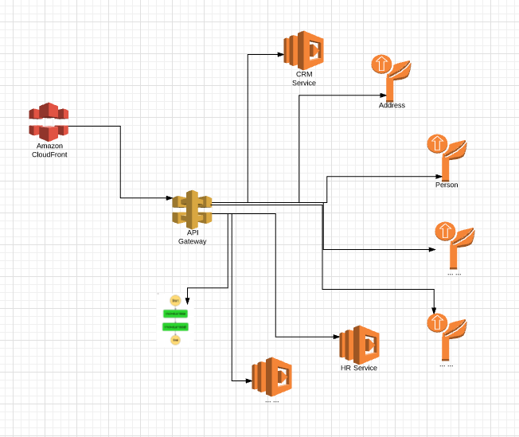

What Did We Set Up?
We
Provide ownership of a domain.
Obtained a certificate.
Installed the certificate.
Alice
Whether a person or REST client.
Can authenticate Bob.
And authenticate to Bob if,
They share a secret
Or trust someone else.

Slide 34
In Reality
The client – CloudFront connection is distributed and extremely local with file and REST API caching.

Slide 35
Once Again, …
This was a very AWS specific explanation for simplicity.
There are lots of technology choices for individual elements.
Any realistic, non-trivial application solution requires
HTTPS
Obtaining and installing certificates.
Something implementing a single site image for multiple systems, and perhaps multiple data centers.
Caching and request routing.
API management and optimization.

Slide 36
Seeka TV Demo Email, FB, Twitter OAuth2

Slide 37
Demo

Slide 38
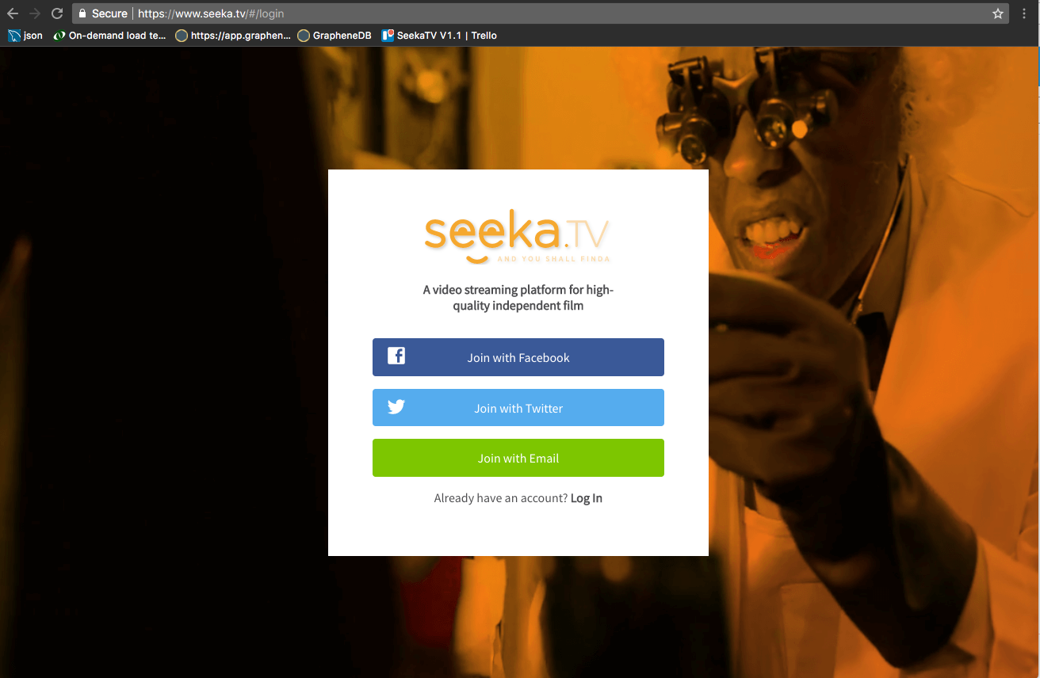
Registration

Slide 39
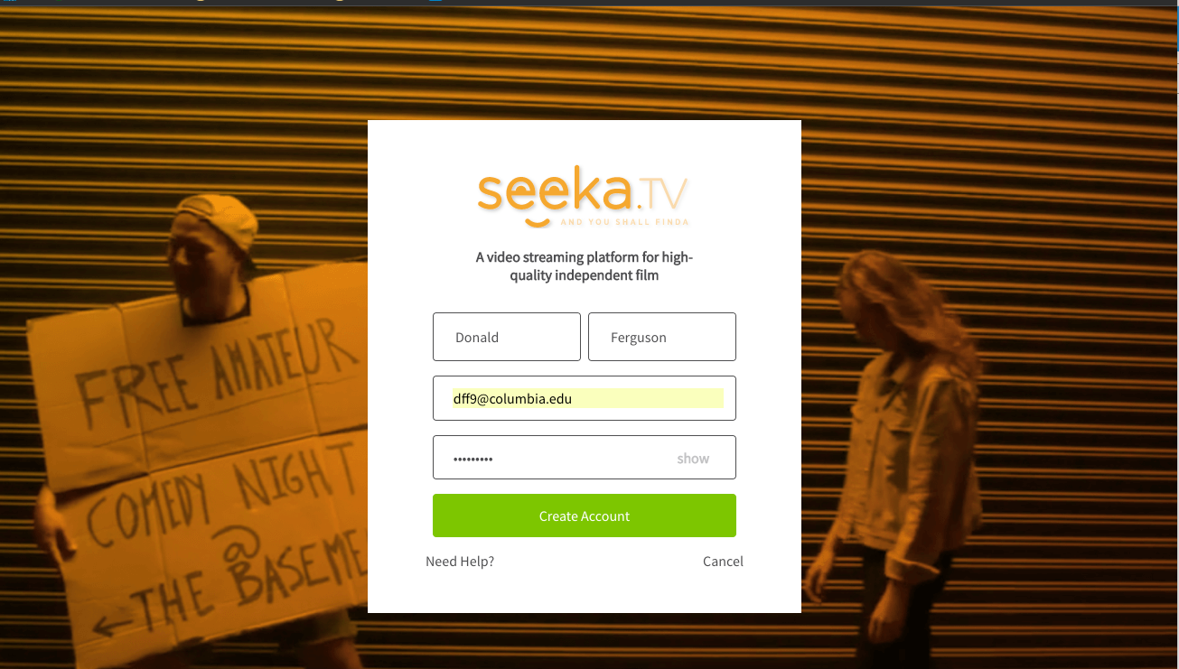
Registration

Slide 40
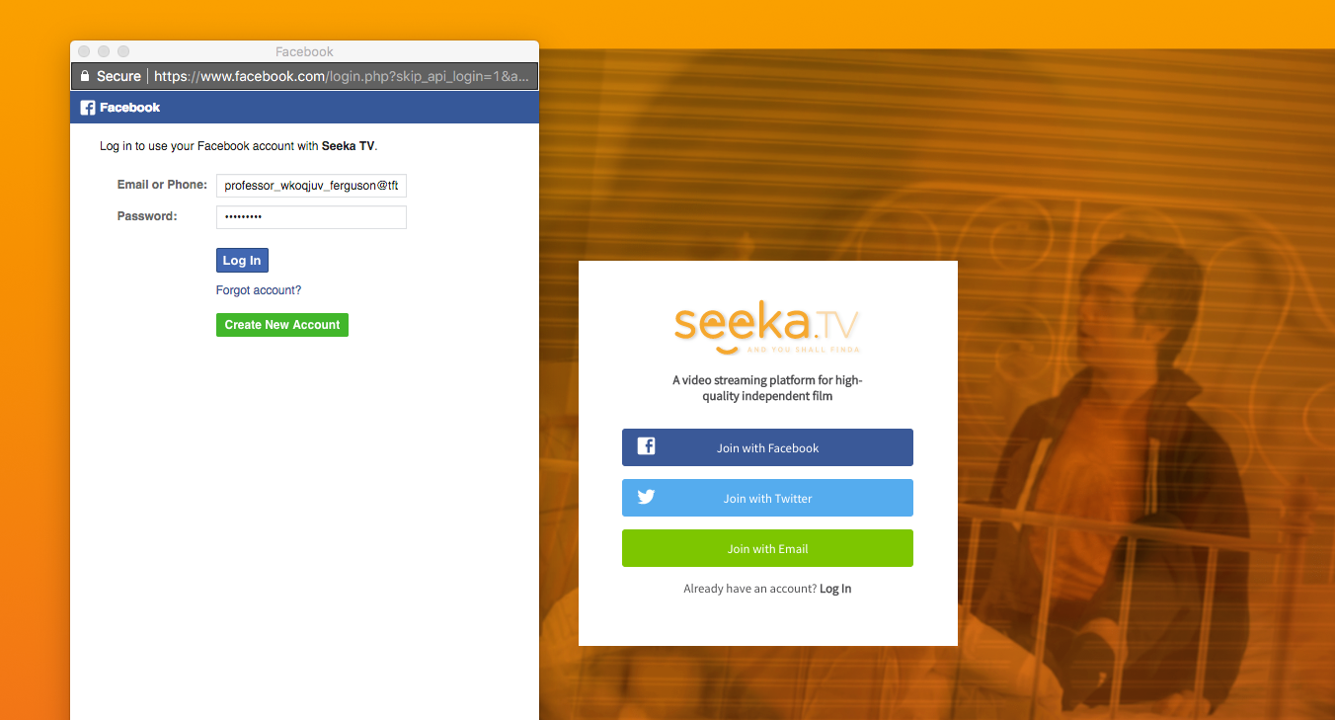
Registration

Slide 41
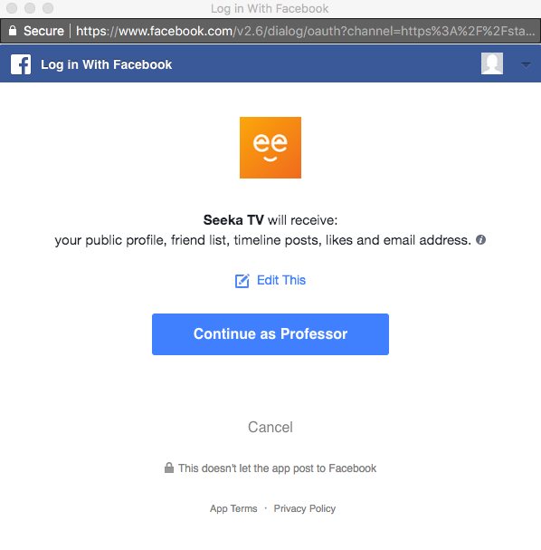
Registration

Slide 42
Pros and Cons of Social Media Logon (https://econsultancy.com/blog/61911-the-pros-and-cons-of-a-facebook-login-on-ecommerce-sites)
Pros
One password for many services: Some people hate making up passwords
Familiarity: People trust Facebook and may not want to give you info.
Added convenience drives business: “Forced registration is a major cause of checkout abandonment, with a quarter (26%) of respondents in a recent Econsultancy survey stating that being forced to register would cause them to abandon a purchase.”
Sharing: Simplifies customers sharing their use of your site → drives awareness.
Access to profile data: Do not require users to enter a new profile.
Your site does not have to have code for password reset, locked account, etc.
Cons
Some users don’t want everything to be connected.
Some people don’t use Facebook.
Muddying your brand image.

Slide 43
Email

Slide 44
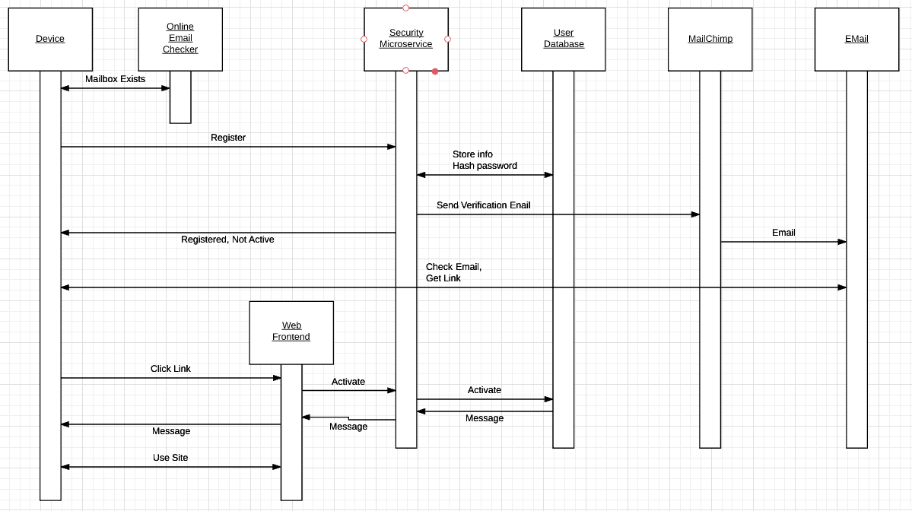
Email Registration

Slide 45
Email Registration
Quick, simple check that email account exists.
Verify ownership of email account.

Slide 46
Social Media Registration (Facebook)

Slide 47
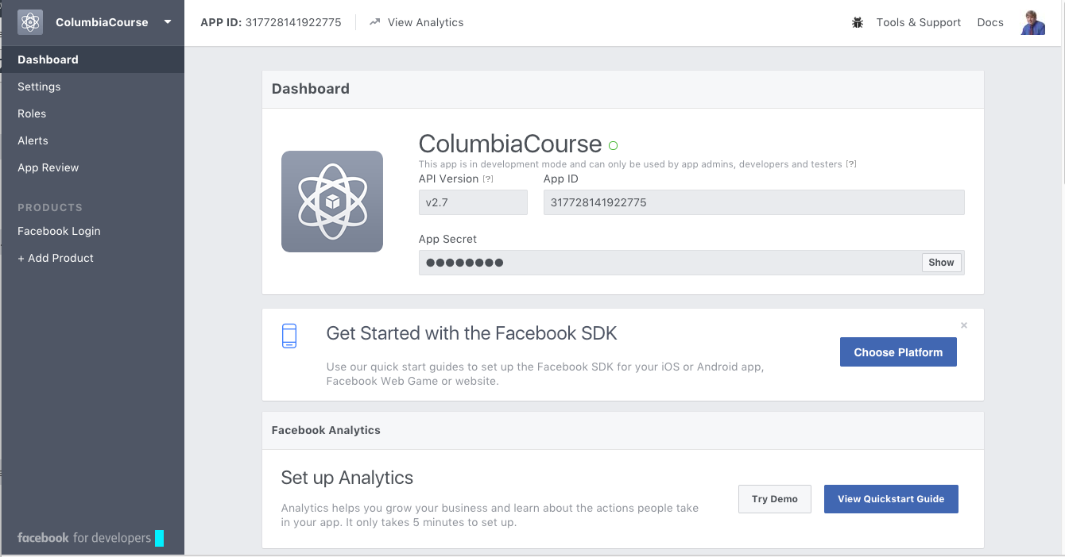
Define Application

Slide 48
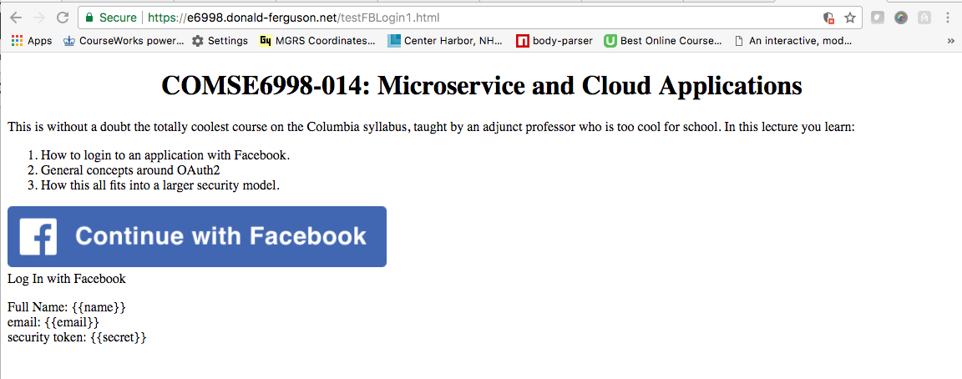
Web Page

Slide 49
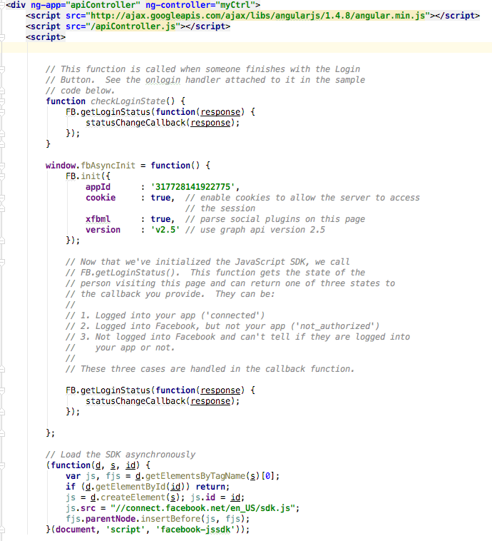
Code (I)

Slide 50
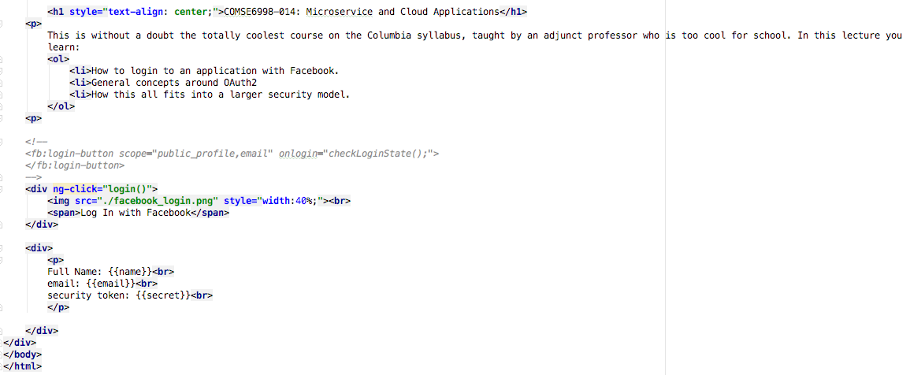
Code (II)

Slide 51
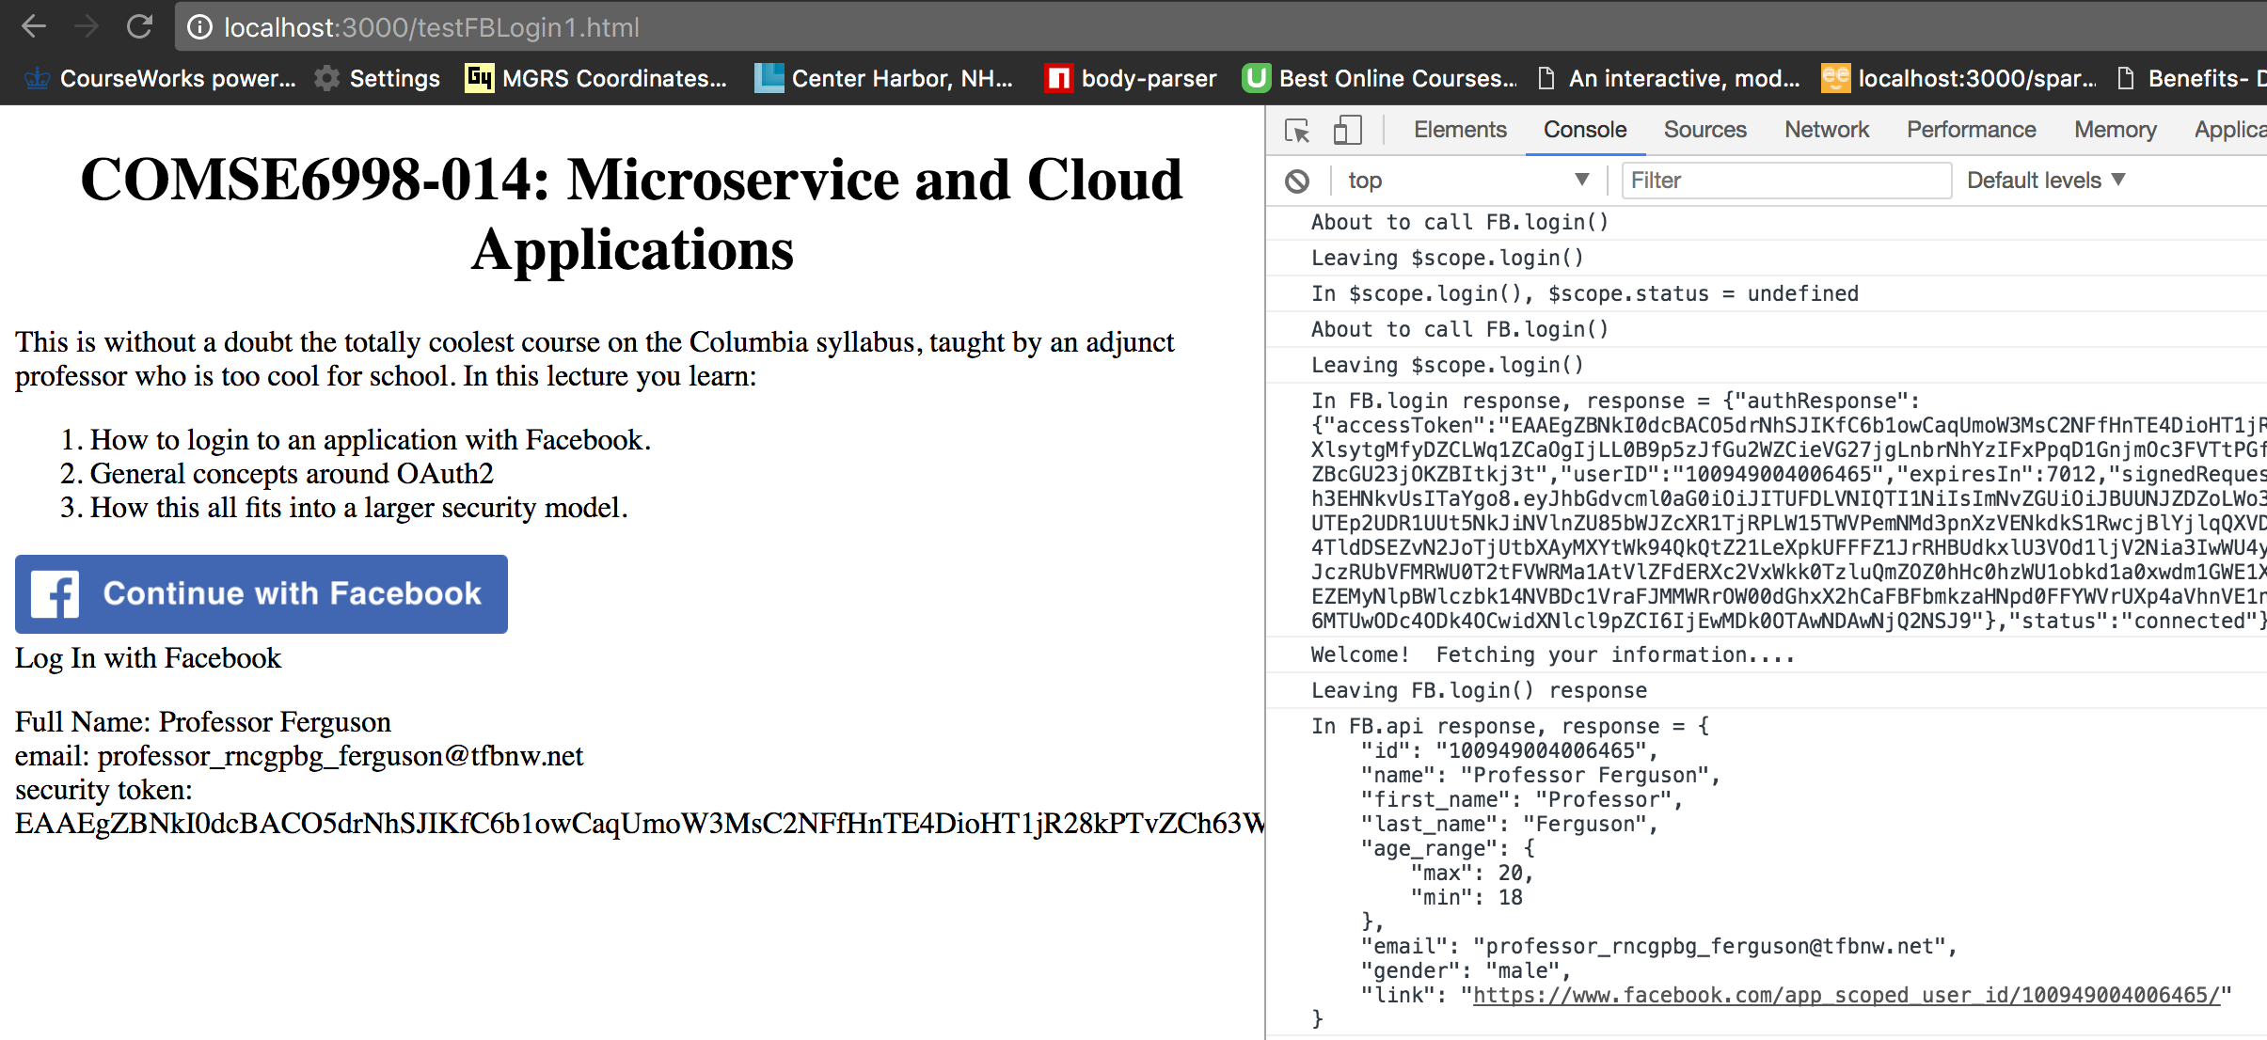
Facebook Login

Slide 52
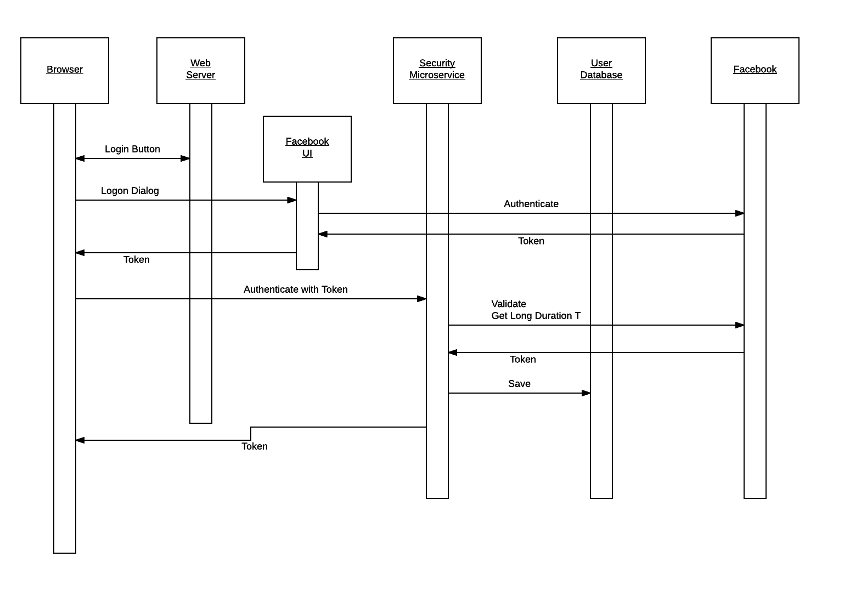
Facebook Login
JWT Token

Slide 53
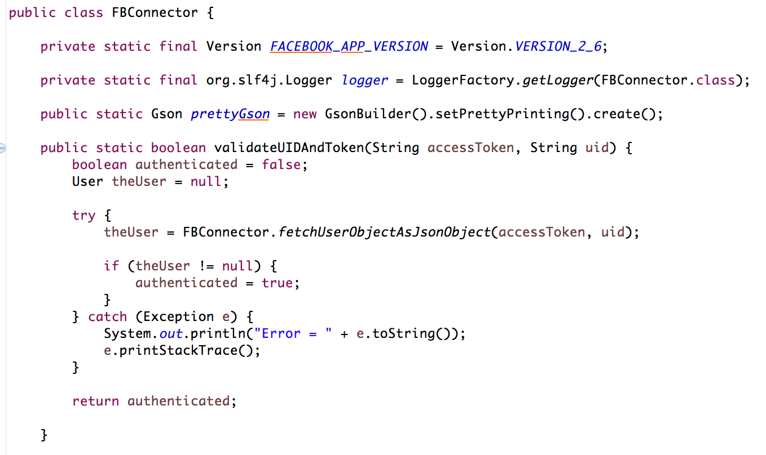
Validate Token

Slide 54
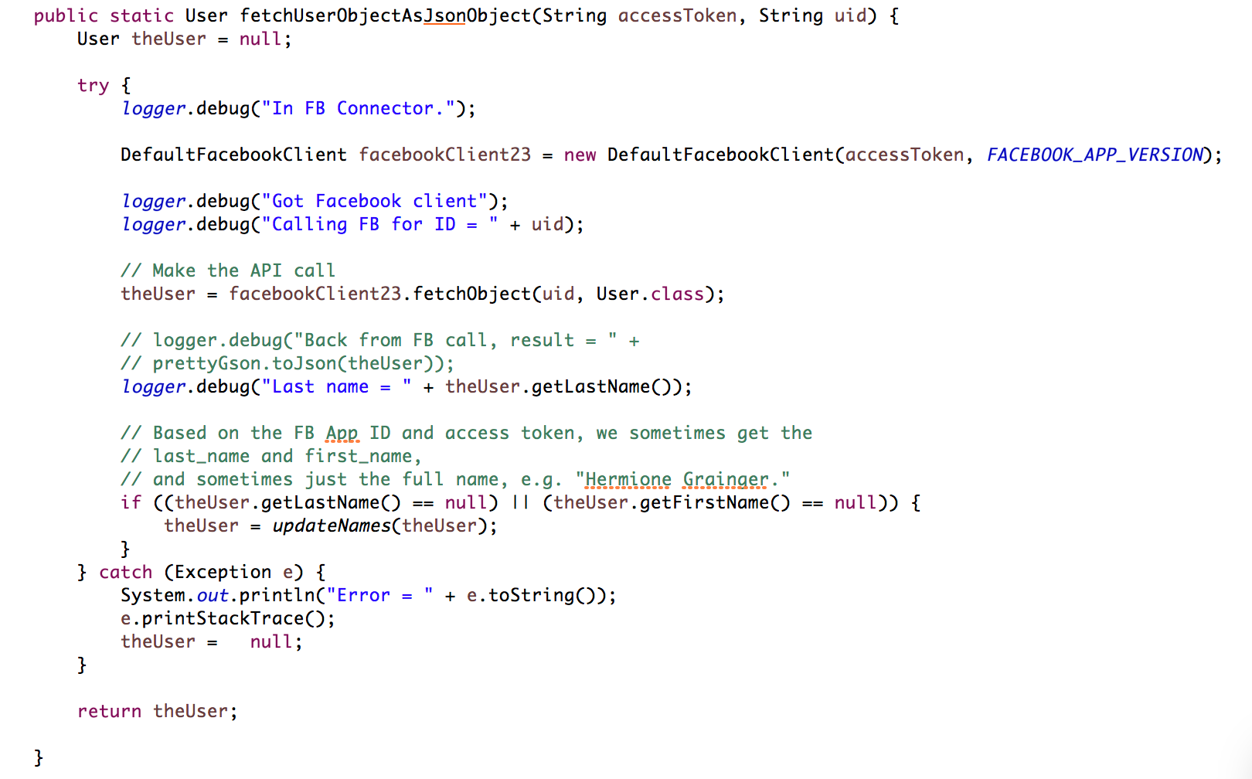
Validate Token

Slide 55
Facebook Token

Slide 56
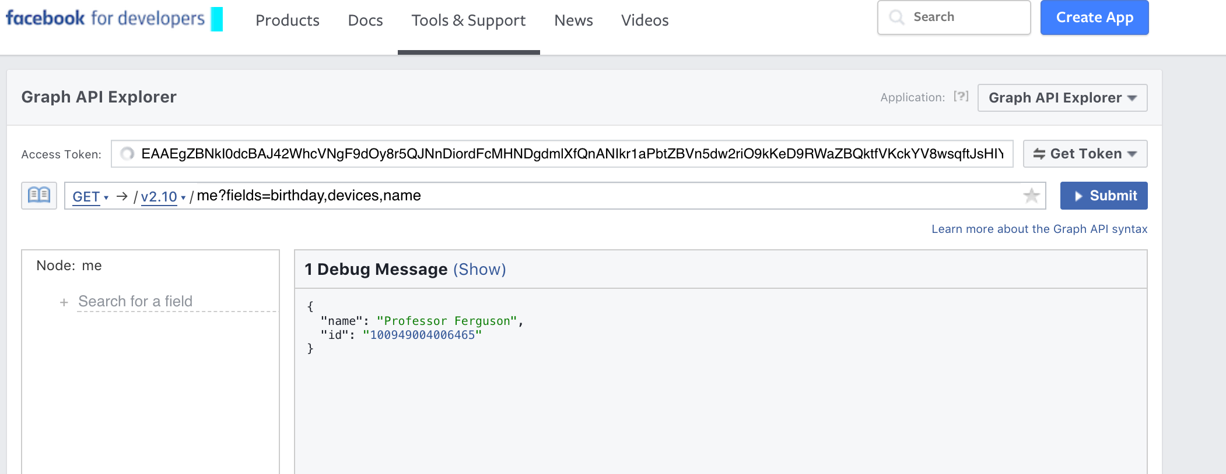
Graph API Explorer Demo

Slide 57
OAuth Twitter and Others

Slide 58
Overview (http://tutorials.jenkov.com/oauth2/index.html)
Resource Owner
Controls access to the “data.”
Facebook user, LinkedIn user, …
Resource Server
The website that holds/manages info.
Facebook, LinkedIn, ...
And provides access API.
Client Application
“The product you implemented.”
Wants to read/update
“On your behalf”
The data the data that the Resource Server maintains, e.g. posts, status, tweets, ...
Authorization Server
Grants/rejects authorization
Based on Resource Owner decisions.
Usually (logically) the same as Resource Server.

Slide 59
Roles/Flows
User Clicks “Logon with XXX”
Redirect user to XXX
With Client App application ID.
And permissions app requests.
Code MAY have to call Resource Server to get a token to include in redirect URL.
Browser redirected to XXX
Logon on to XXX prompt.
Followed by “do you grant permission to …”
Clicking button drives a redirect back to Client App. URL contains a temporary token.
User/Browser
Redirected to Client App URL with token.
Client App calls XXX API
Obtains access token.
Returns to User.
Client App can use access token on API calls.

Slide 60
Authorization

Slide 61
Custom Authorizer
Previous
Login Flow

Slide 62
Authorization
1st check occurs at perimeter in API GW Authorization
Based on (bearer token) JWT token
Is this role authorized to invoke this URL?
Implementation
Lambda function that …
Checks an authorization table (role, URL)
Or the rights are encoded in the token.
All down stream microservices
Receive the JWT token and perform their own authorization decisions.
Run with a set of AWS roles and permissions that determine if AWS allows access, which may include user role.

Slide 63
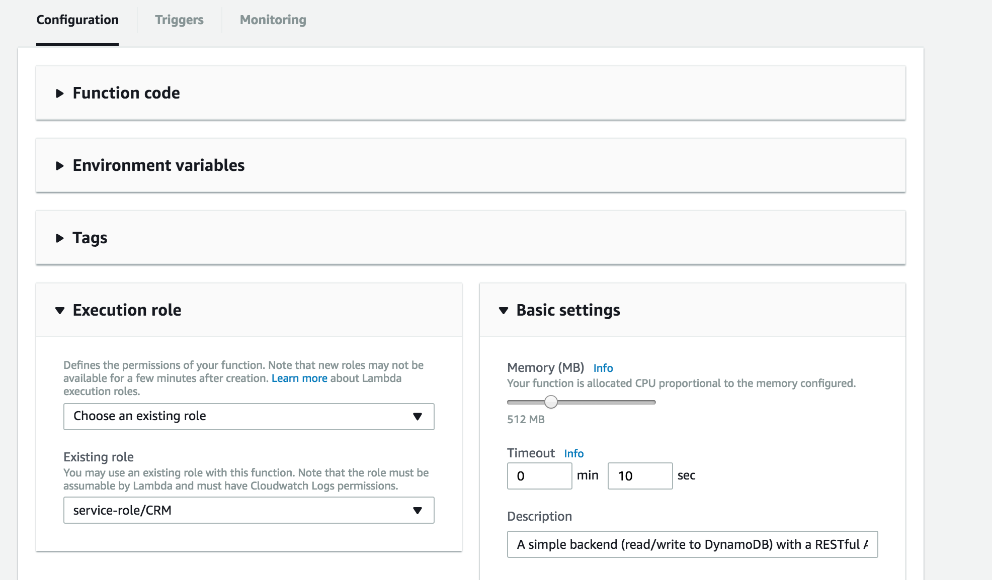
An Example – Lambda Function Role

Slide 64
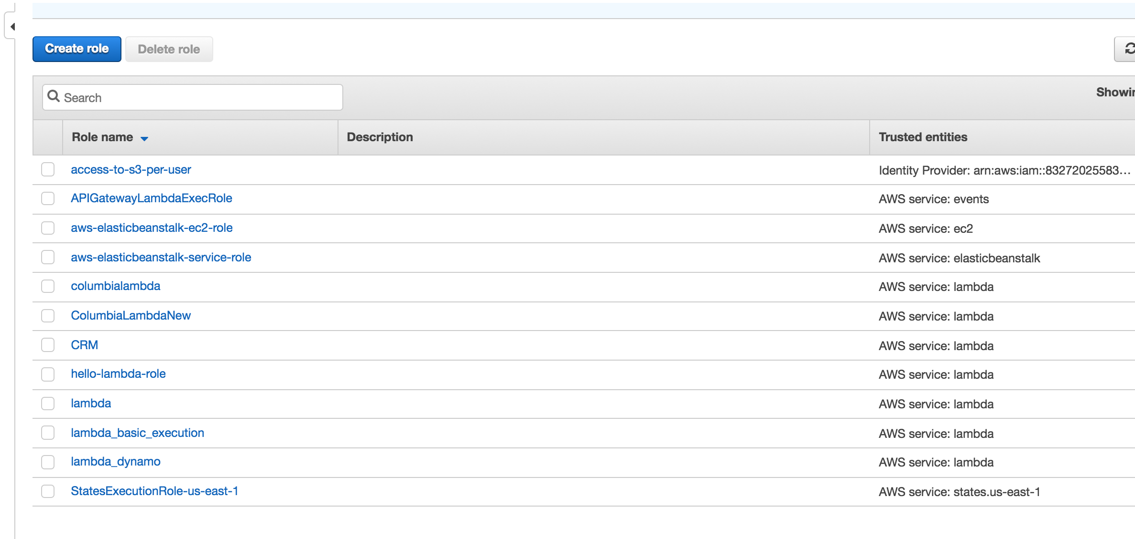
Role/Policies

Slide 65
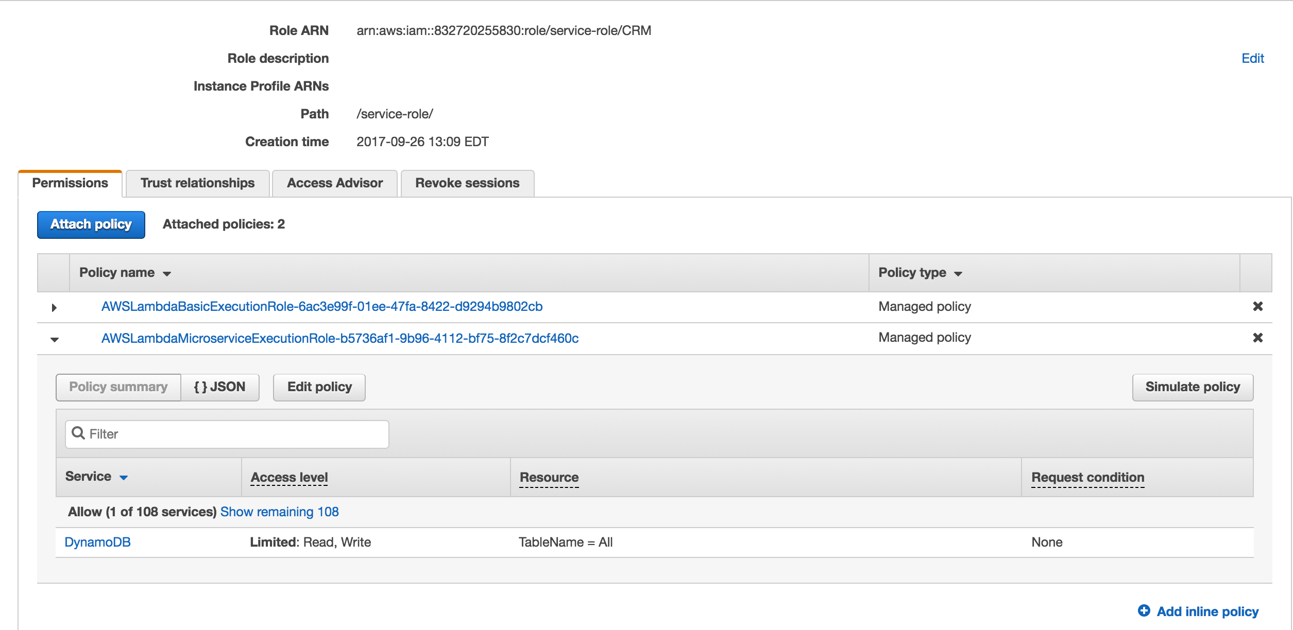
Role/Policy

